Slide 1
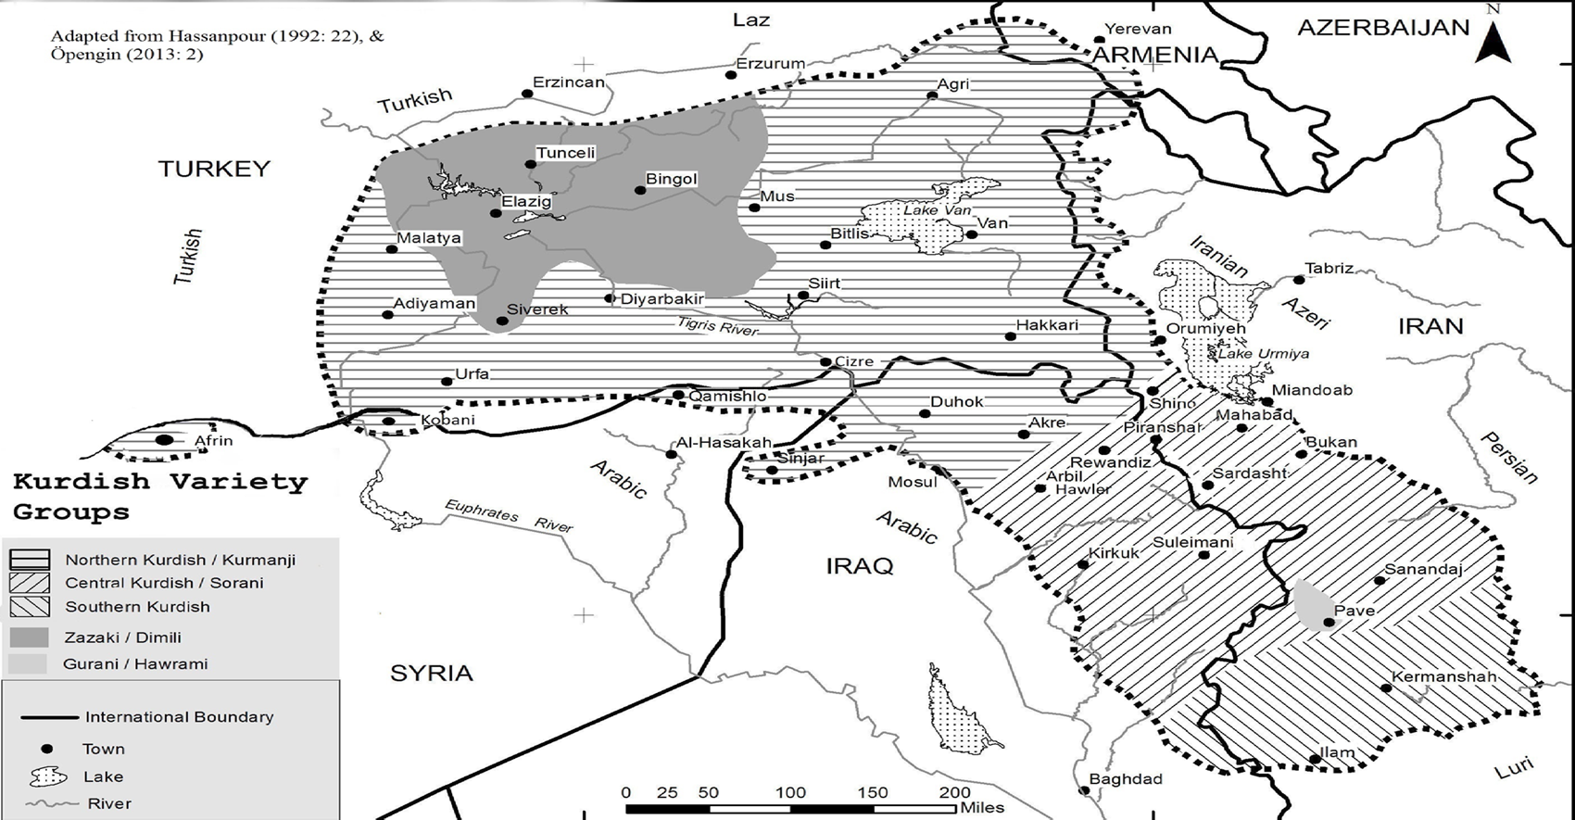
KURD-AKAD UK The use of Kurdish language in Kurdistan and the Diaspora

Slide 2
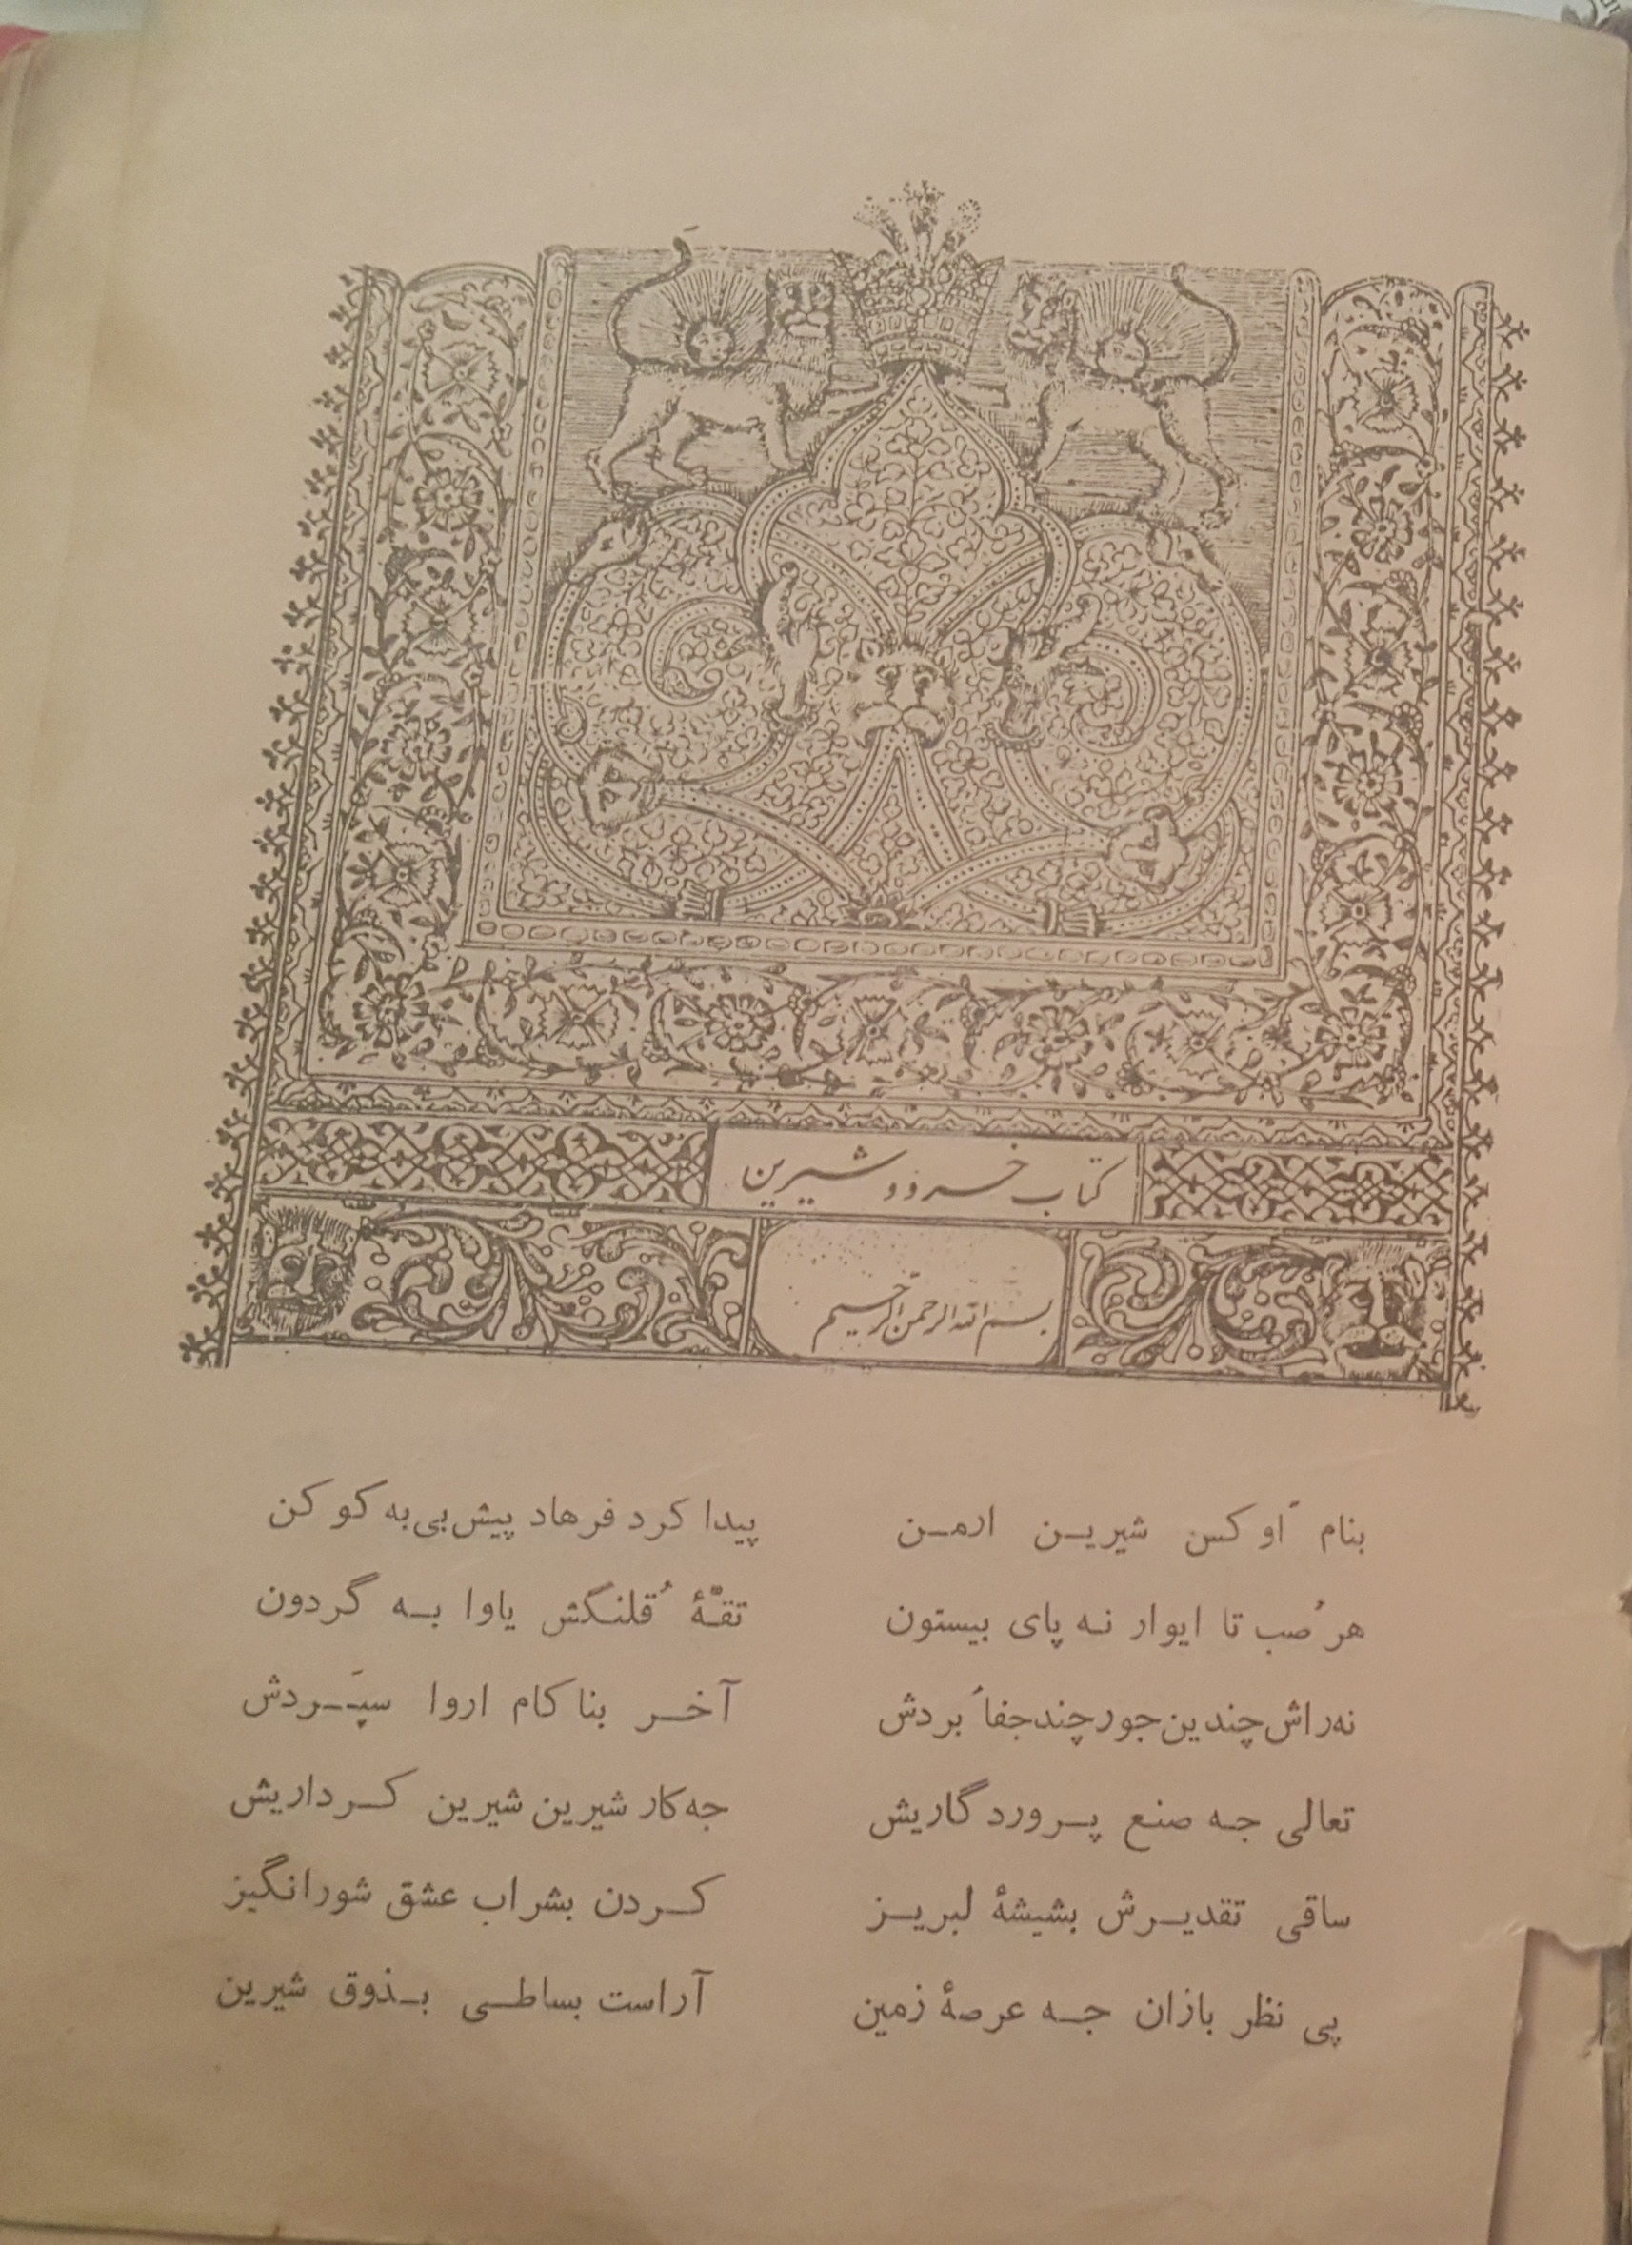
Pey çêş ne dewran ey dinyay bedkêş Mehzuzen her kes be zubanê wêş
Rasten mewaçan Farsî şekerern
Kurdî ce lay min bel şîrînterin
Xanay Qubadî (1700-1759)
For some reason in this cruel world
Everyone is happier with their [own] language
Although it is said that “Farsi is sugar,”
Kurdish is much sweeter, if you ask me.

Slide 3
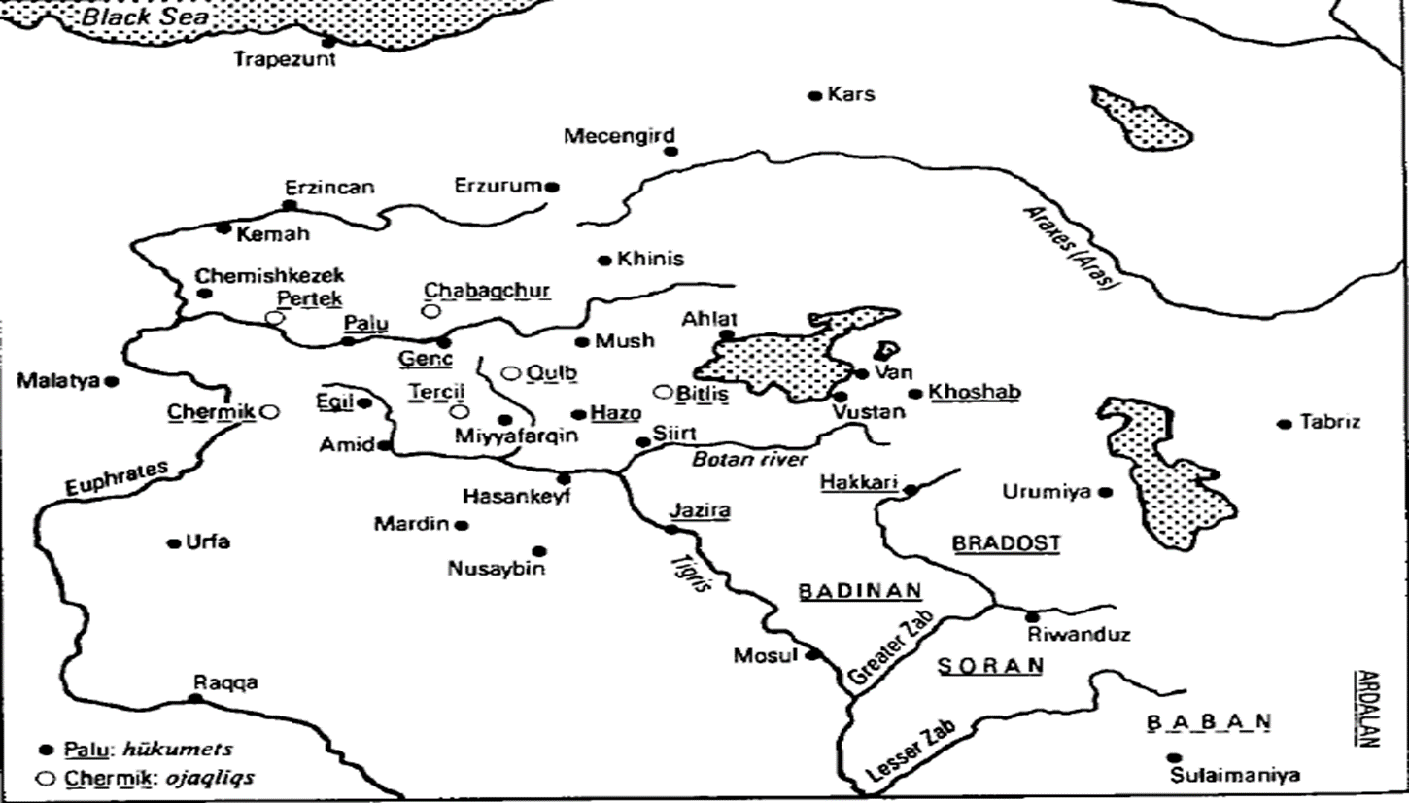
Kurdish principalities in the Ottoman & Persian Empire

Slide 4
Kurdish literary tradition
GORANI
KURMANJI
SORANI
The oldest literary tradition emerged from the 16th century in the Ardalan principality
Flourished from the 16th century in the Kurdish principalities of the Ottoman Empire such as Hakari and Botan
Emerged in the late 18th century under the patronage of the Baban principality in the Ottoman Empire

Slide 5
Kurdish dialects/ language varieties

Slide 6
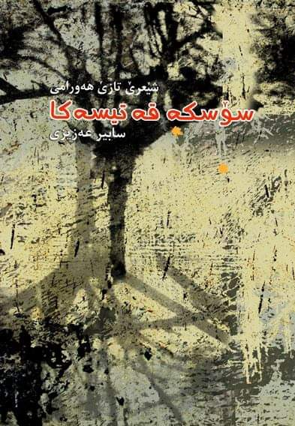
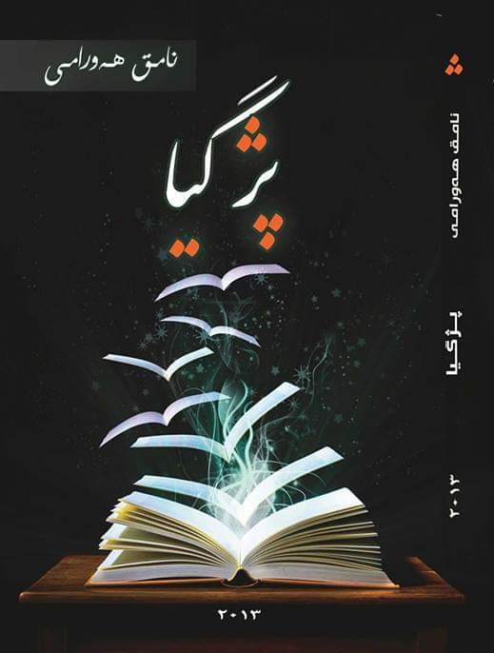
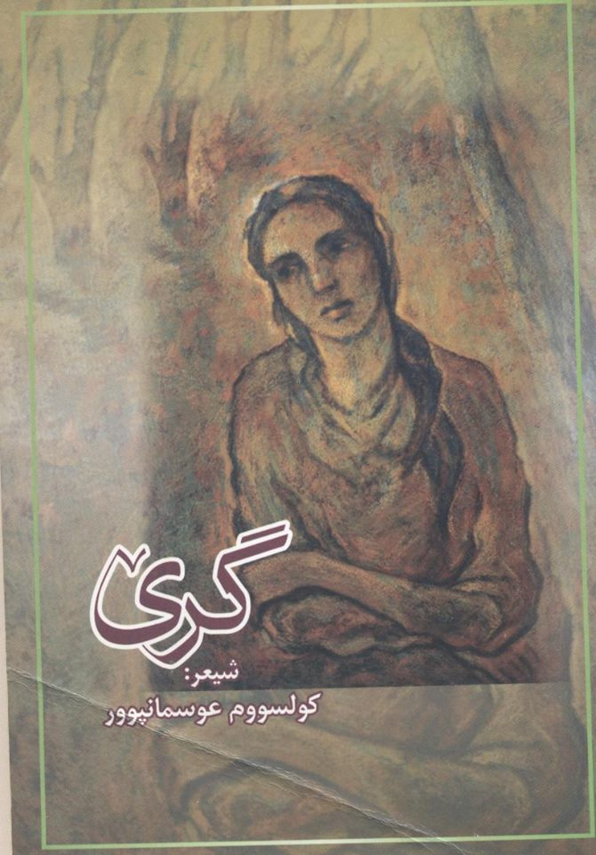
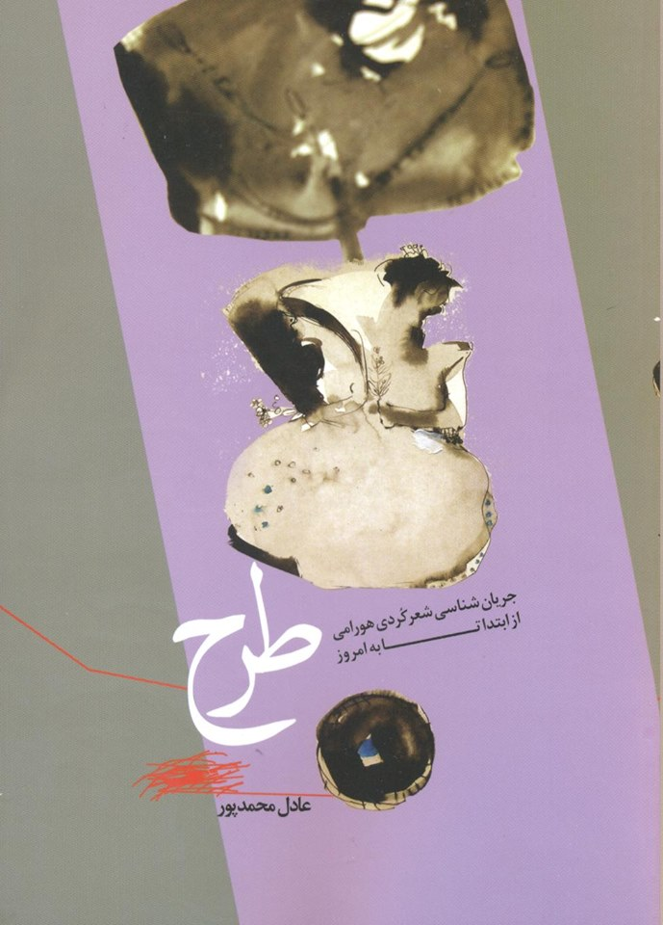
Recent Gorani publications

Slide 7
Kurdish language policy in Iran
* Iran is a multi lingual, multi-ethnic country: 76 language
* Kurdish is the third largest language in Iran (about 6–7 million speakers),
1925–1941: “one-nation, one-language” policy
1941–1979 (Mohammad Reza Shah):
1941-1946: continuation of assimilation policies
1946: the Kurdish Republic; Sorani Kurdish (Sorani) was declared as the official language
1946–1979: “controlled and limited” relaxation of the assimilation policies; limited Kurdish publications

Slide 8
:
1979:
Article 15 of Section 2 of the Constitution reads:
“The official language and script of Iran, the lingua franca of its people, is Persian. Official documents, correspondence, and texts, as well as text-books, must be in this language and script. However, the use of regional and tribal languages in the press and mass media, as well as for teaching of their literature in schools, is allowed in addition to Persian.

Slide 9
:
1979: “limited, restricted and controlled tolerance”
Article 15 of Section 2 of the Constitution reads:
“The official language and script of Iran, the lingua franca of its people, is Persian. Official documents, correspondence, and texts, as well as text-books, must be in this language and script. However, the use of regional and tribal languages in the press and mass media, as well as for teaching of their literature in schools, is allowed in addition to Persian.

Slide 10
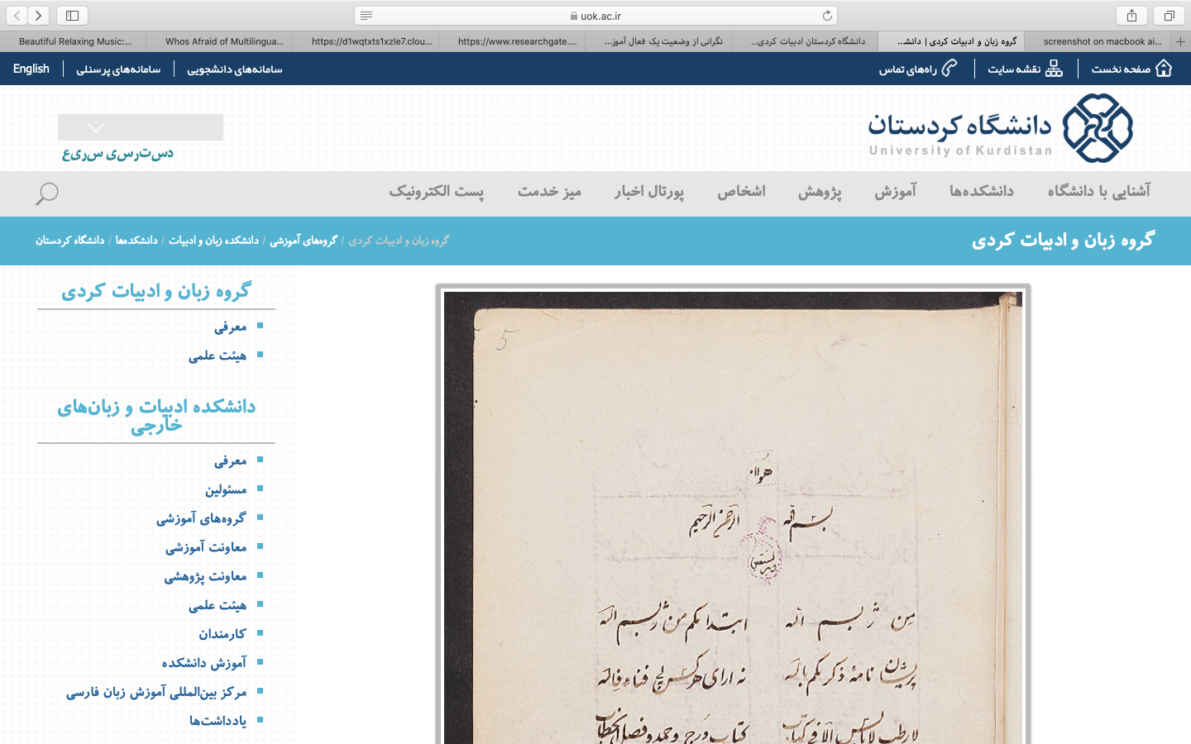

Slide 11
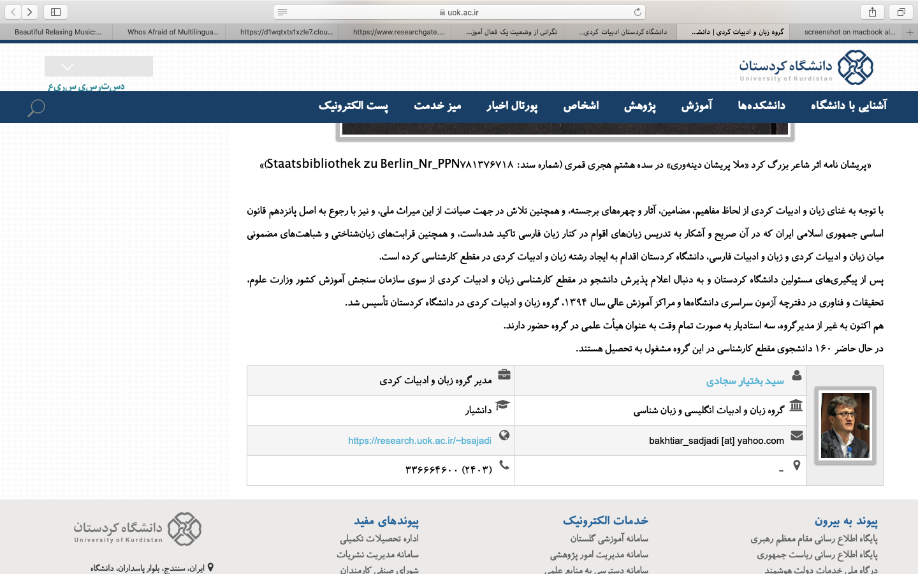

Slide 12
Selected references
Haig, G., & Öpengin, E. (2014). Introduction to Special Issue: Kurdish: A critical research overview. Kurdish Studies 2(2), 99–122.
Hassanpour, A. (1992). Nationalism and language in Kurdistan, 1918-1985. San Francisco: Mellen Research University Press.
Hassanpour, A. (1998). The Identity of Hewrami Speakers: Reflections on the Theory
and Ideology of Comparative Philology. In A. Soltani (ed.). Anthology of Gurani
Kurdish Poetry (35–49). London: Soane Trust for Kurdistan.
Hassanpour, A. (2012). The indivisibility of the nation and its linguistic divisions. International Journal of the Sociology of Language, 217, 49–73.
Hassanpour, A., Sheyholislami, J., & Skutnabb-Kangas, T. (2012). Introduction-Kurdish: Linguicide, resistance and hope. International Journal of the Sociology of Language, 217, 1–18.
Sheyholislami, J. (2012a). Kurdish in Iran: A case of restricted and controlled tolerance. International Journal of the Sociology of Language, 217, 19–47.

